Slide 1
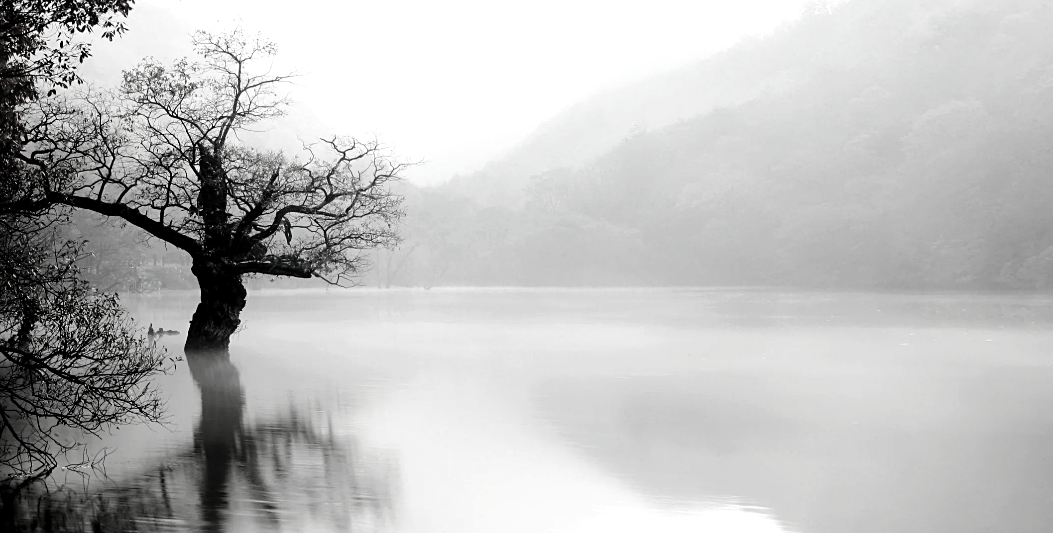
FRAMING MY CULTURAL HERITAGE RESULTS
PHOTOGRAPHY CONTEST 2024

Slide 2
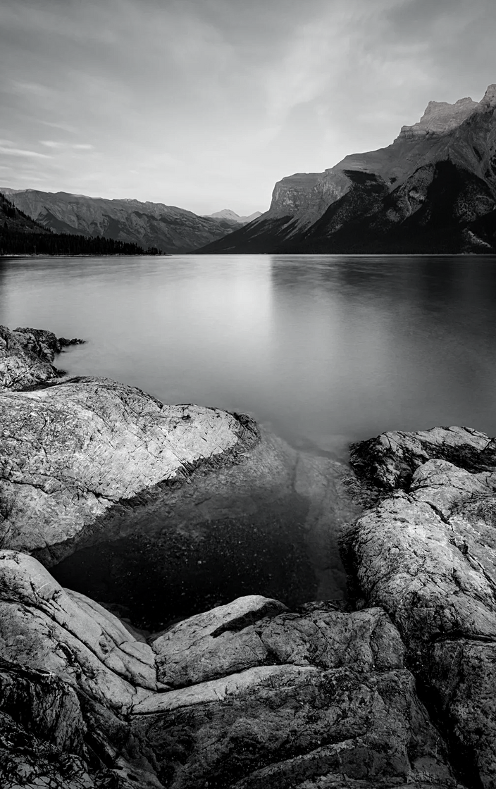
OBJECTIVE
To capture a special cultural aspect of a student’s community, city or country which will attract or engage people to want to visit that place. The photo should entice people to want to know more or see themselves in that place. An explanatory caption is required.

Slide 3
NATIONAL WINNERS

Slide 4
LA PORTE DU CHATEAU DE ROCHEFORT-EN-TERRE
Photographer: Perrine Queverdo
Culture and Heritage. The Chateau de Rochefort-En-Terrs is home to the ruins of a medieval fortress (12th century). The grounds of the castle, known as “The Painters’ Garden” are now a bird sanctuary and has been awarded the LPO (League for the Protection of Birds) label. The Chateau has been owned by the town since 2013.
RUE DU CHATEAU, FRANCE

Slide 5
MY MOMENT WITH HISTORY
Photographer: Lau Ying Wai
Central Ferry Piers is a pier with a long history. It adopts Victorian architecture and its architectural style is very characteristic of HK culture.
HONG KONG CENTRAL

Slide 6
SIC TRANSIT GLORIA MUNDI
Photographer: Zsofia Daradics-Borsos
This church was built between 1220-1234 in late Roman and early Gothic style. During the medieval ages, it was quite rich because it had large properties around. There were numerous monks living there. In 1763, there was a huge earthquake which destroyed the church. Nowadays, it is a monument.
ZSAMBEK, HUNGARY

Slide 7
TRANQUIL GADISAR LAKE
Photographer: Tank Manav Nareshbhai
Embracing the Gadisar Lake: A symphony of serenity and wonder
JAISALMER, RAJASTHAN, INDIA

Slide 8
A TRANQUIL DRIFT ALONG RIO GRANDE
Photographer: Jordan Willory
Jamaica, the land of wood and water. This photo encapsulates our heritage, displaying the tranquility of navigating the Rio Grande on a bamboo raft, symbolizing our connection to nature and tradition.
PORTLAND, JAMAICA

Slide 9
NO TITLE
Photographer: Rohan Khatri
A serene temple standing as a testament to spiritual heritage, surrounded by lush greenery and mountains, inviting peace and reverence.
SURKHET, NEPAL

Slide 10
TOURIST DESTINATIONS IN THE SULTANATE OF OMAN
Photographer: Abdullah Abdulaziz Ahmed Al-Balushi
The majestic landscape of Sur, Sultanate of Oman, where forts meet the rugged mountains and the sea, capturing the essence of this renowned trade hub. The views that attract the attention of tourists every single time.
SUR, OMAN

Slide 11
REMEMBER OUR FORGOTTEN LEGENDS
Photographer: Janco van der Merwe
This is a photo of a tombstone at a forgotten graveyard. No tombstone has a name or description. The only remembrance of the buried people and their legend is in bedtime stories.
CONCENTRATION CAMP GRAVEYARD, SOUTH AFRICA

Slide 12
TANZANIA TRADITIONAL FOOD PHOTO COMPETITION
Photographer: Agnes Satura
The photo shows the love, hospitality and passion that come from the people who have prepared the food as they prepared them for the visitors both local people and foreigners to enjoy and to honour the traditions from different cultures found in Tanzania.
DAR ES SALAAM, TANZANIA

Slide 13
THE WINNING PHOTOS

Slide 14
FIRST
INDIA
TANK MANAV NARESHBHAI
SECOND
JAMAICA
JORDAN WILLORY
THIRD
SOUTH AFRICA
JANCO VAN DER MERWE
INTERNATIONAL WINNERS

